Slide 1
Clayton Anderson
Neutron Scattering
Phys 211A - Solid State Physics 1
17 December 2014

Slide 2
Outline
Basic Principles
- Scattering, Bragg’s law
- Elastic vs. Inelastic
- Coherent vs. Incoherent
- Neutron specific properties
- Penetration Depth
- Small Cross Sections
- Generating the beam
Applications
- “Generic” neutron scattering
- Powdered neutron diffraction
- Magnetic Scattering
Atomic Structure of a HEA
- What is a HEA?
- Results

Slide 3
Basic Principles
A beam of neutrons impinges on a sample, resulting in scattering. Scattering occurs for specific orientations of the crystal and specific wavelengths of the neutrons. This relationship is given by Bragg’s law:
Neutrons do not have an electronic charge, so they scatter off nuclei instead of electron clouds.
  Small probability of scattering
  Penetration Depth
  Scattering amplitude depends on neutron - nuclei interaction

Slide 4
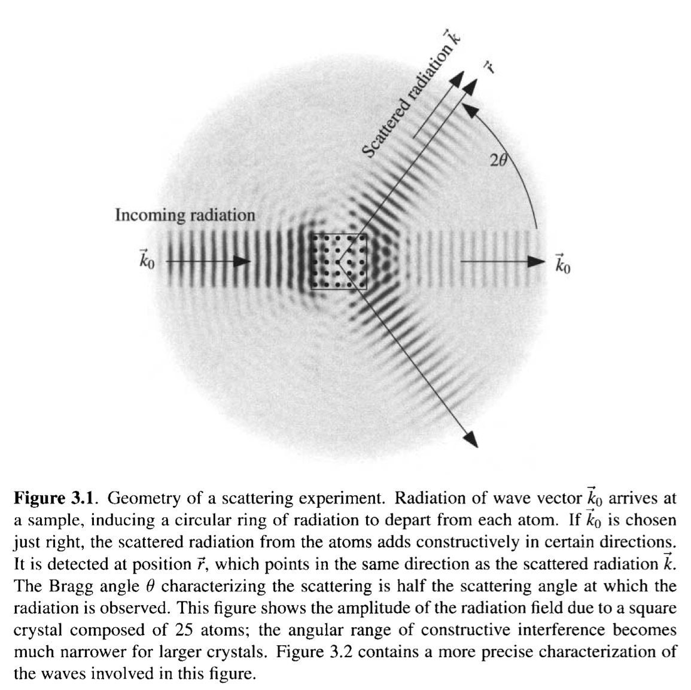
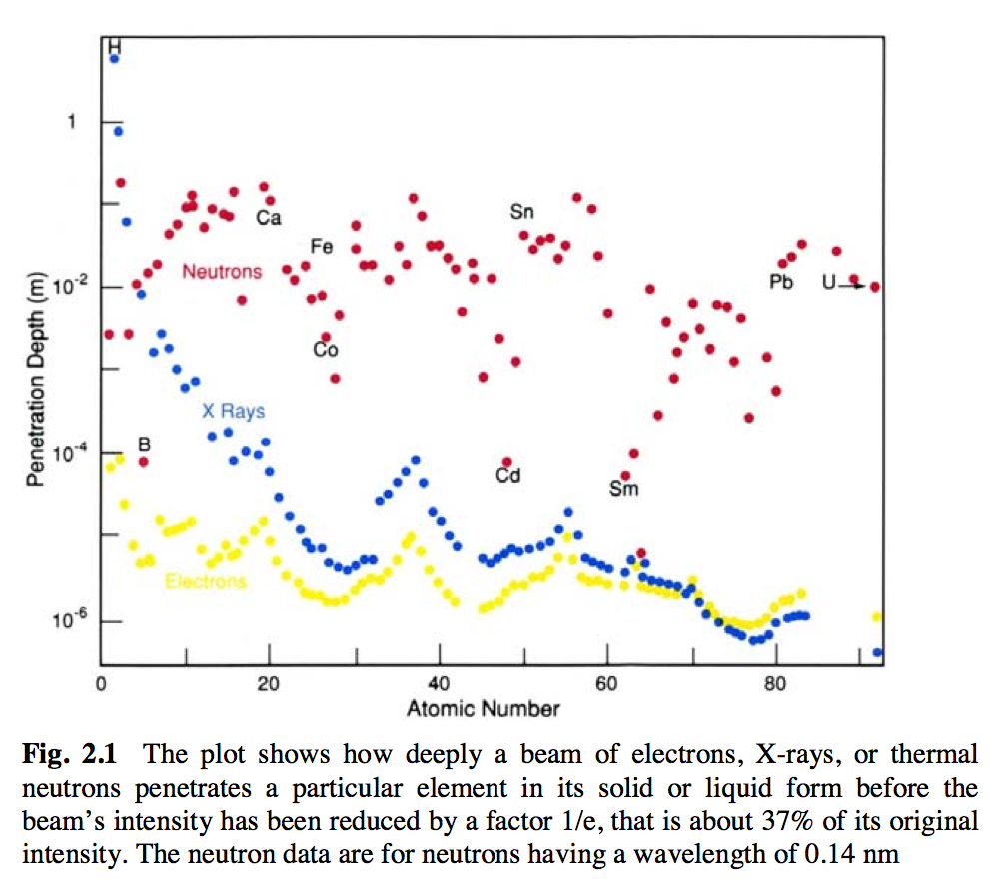
Marder, chapter 3
Pynn, Chapter 2

Slide 5
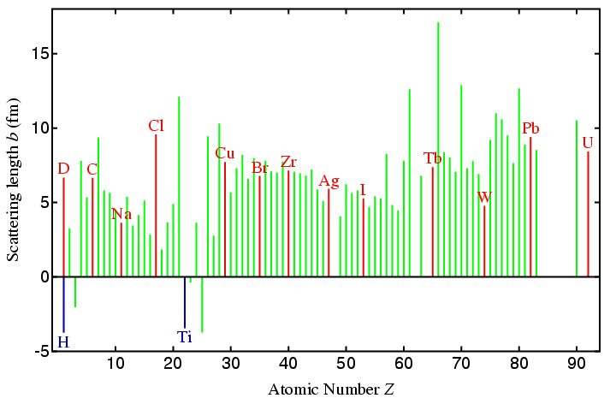
http://pd.chem.ucl.ac.uk/pdnn/inst3/neutrons.htm

Slide 6
Generating the Beam
How do we get neutrons?
Spallation: high-energy protons impact on liquid mercury, ejecting neutrons.
Nuclear Fission Reactors: neutrons are generated by the decay of Uranium
n+²³⁵U −→²³⁶U −→⁹²Kr+¹⁴¹Ba+ 3n

Slide 7
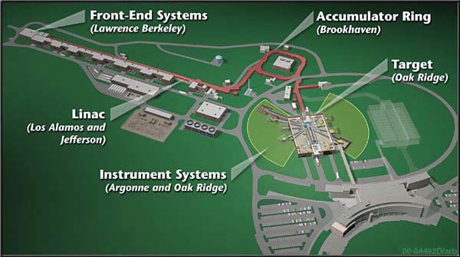
Oak Ridge National Laboratory
http://neutrons.ornl.gov/facilities/SNS/works.shtml

Slide 8
Types of Scattering
Coherent Scattering - Interference between neutrons that scatter from different nuclei.
Incoherent Scattering - Interference between neutrons that scatter from the same nuclei.
Elastic Scattering - No energy is transferred upon collision
Inelastic Scattering - Some energy is transferred upon collision
Coherent elastic scattering is the “usual stuff.”
Coherent inelastic scattering yields information about the vibrations of the crystal (phonons).
Incoherent elastic scattering is noise.
Incoherent inelastic scattering provides information about atomic diffusion.

Slide 9
Magnetic Neutron Scattering
Neutron doesn’t have electronic charge, but it has a magnetic moment due to its quark composition. For magnetic scattering, only the component perpendicular to the scattering vector can impact the scattering.

Slide 10
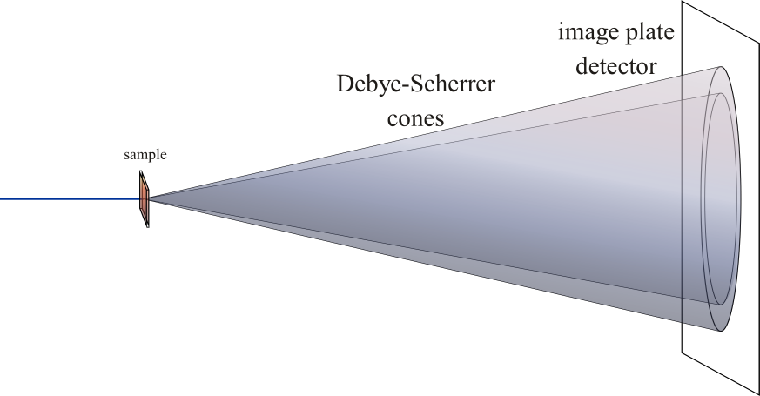
Powdered Neutron Scattering
Neutron beam scatters off a powdered crystal sample, which includes all orientations of crystal planes. This results in rings corresponding to different atomic planes.
http://en.wikipedia.org/wiki/Powder_diffraction

Slide 11
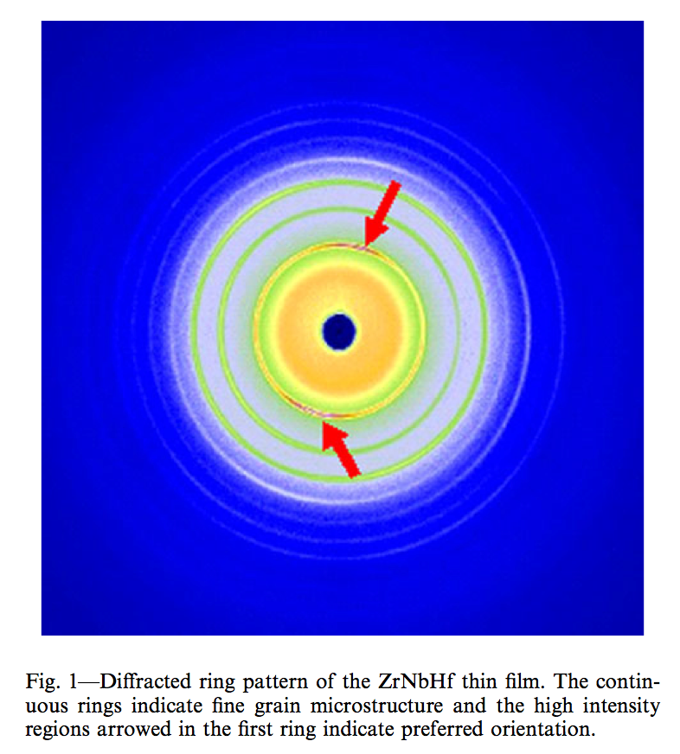
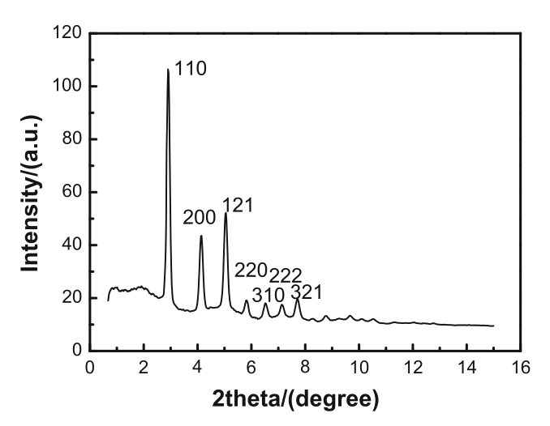
Example of actual data
HEA = High entropy alloy
Results of x-ray and neutron scattering lead show that ZrNbHf has an average b.c.c. structure, but is distorted towards f.c.c.
Guo,Local Atomic Structure

