Slide 1
Atomic Force Microscopy
Dian Shi

Slide 2
Atomic Force Microscopy (AFM)
Basic principles
FM-AFM
Applications
New developments

Slide 3
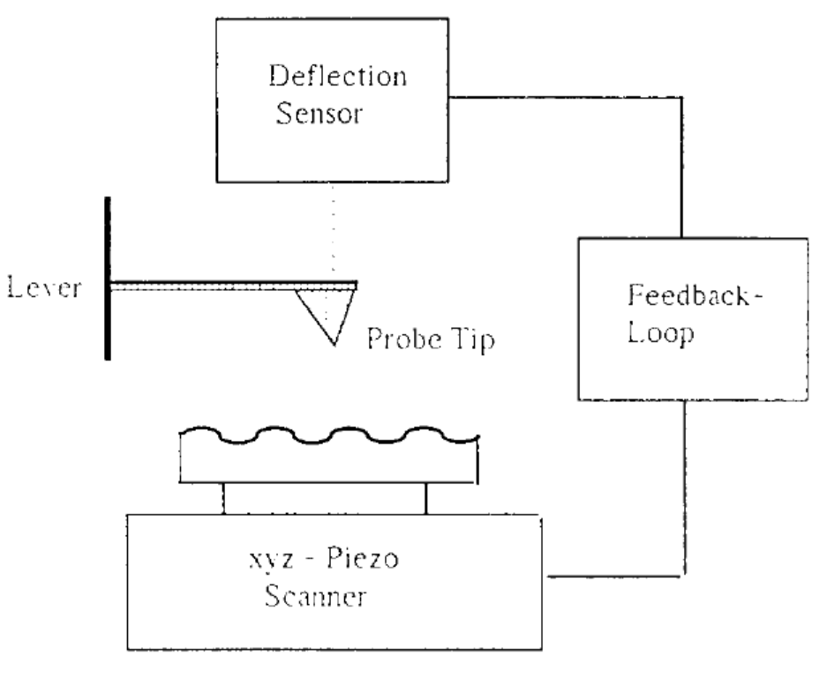
Basic Principles
E. Meyer. “Atomic Force Microscopy.” Progress in Surface Science. 1992

Slide 4
Basic Principles
Tip-sample forces
Van der Waals, Electrostatic, Magnetic, Capillary, Ionic repulsion, Frictional
Cantilever
Stiffness k, Eigenfrequency , Quality factor Q, , Tip’s chemical structure
$$f_{0}$$
$$∂{f_{0}}/∂T$$

Slide 5
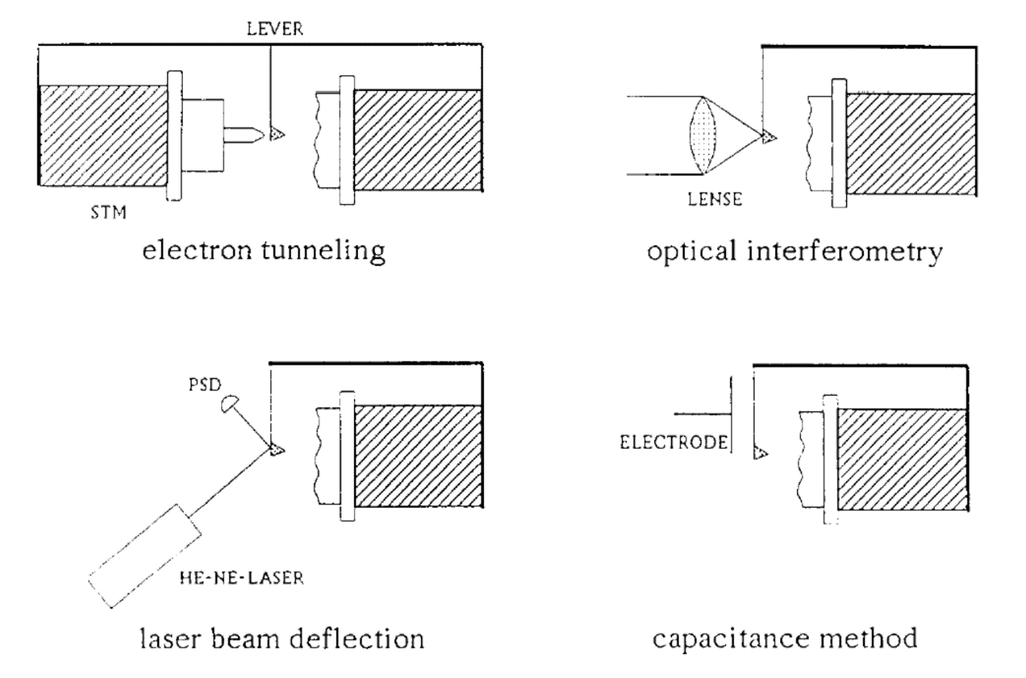
Basic Principles
Deflection sensor
(Meyer, 1992)

Slide 6
Basic Principles
Operation mode
Static (contact) mode
Dynamic (noncontact) mode
Amplitude-modulation (AM)
Frequency-modulation (FM)

Slide 7
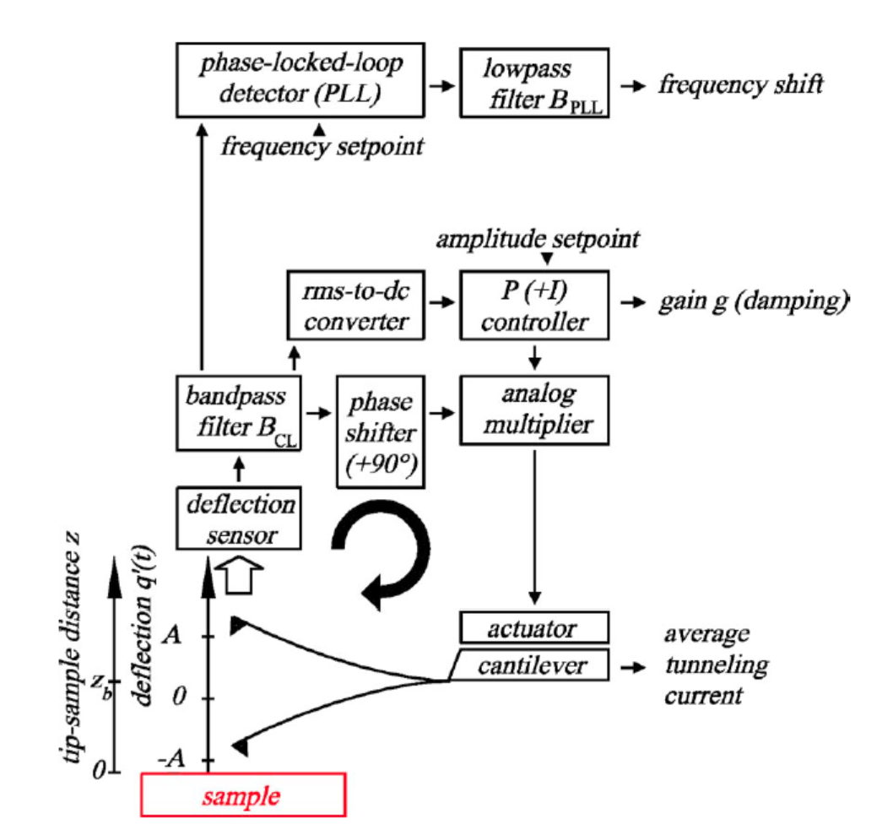
FM-AFM
Experimental setup
(Giessibl, 2003)

Slide 8
FM-AFM
Experimental parameters
Spring constant of the cantilever k
Eigenfrequency of the cantilever
The quality value of the cantilever Q
The oscillation amplitude A
He frequency shift of the cantilever
$$f_{0}$$
$$Δf$$

Slide 9
FM-AFM
Physical observables
Frequency shift
Average tunneling current
Damping and dissipative forces

Slide 10
Applications
Imaging
Spectroscopy

Slide 11
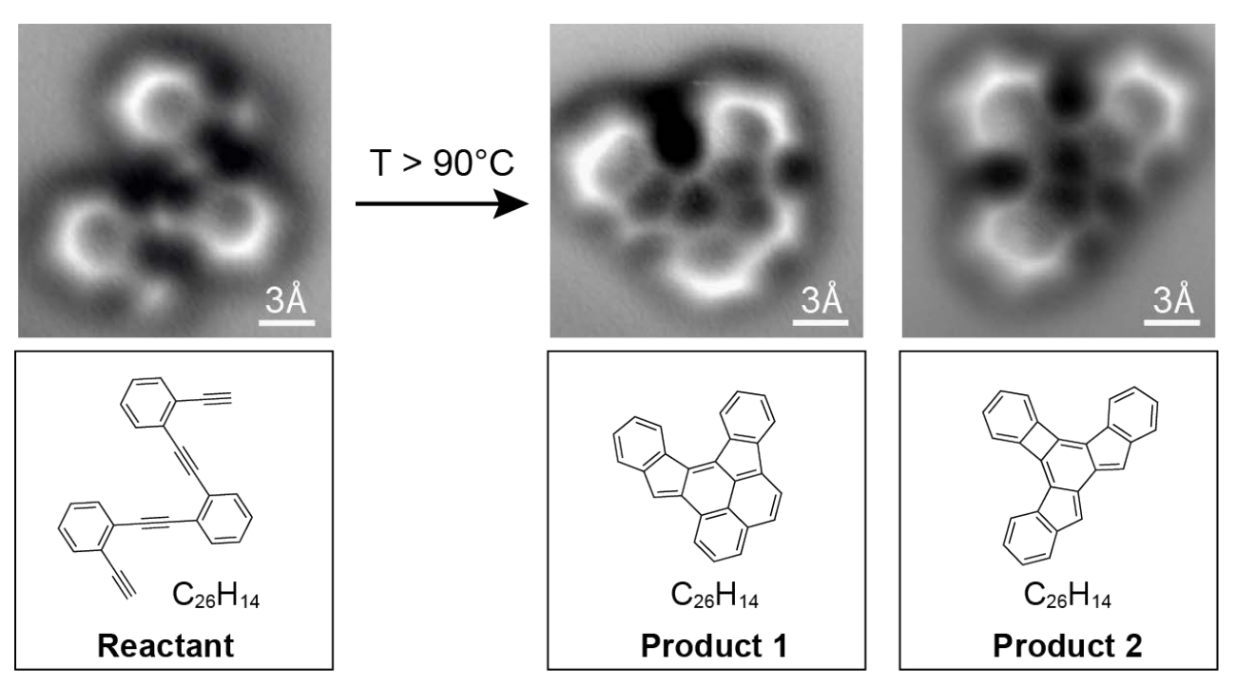
New Developments
Dynamic mode with stiff cantilevers and small amplitudes
Direct imaging of covalent bond structure (Dimas G. de Oteyza, et al.)

Slide 12
Thank You

