Slide 1
Electron Tunneling and the Josephson Effect

Slide 4
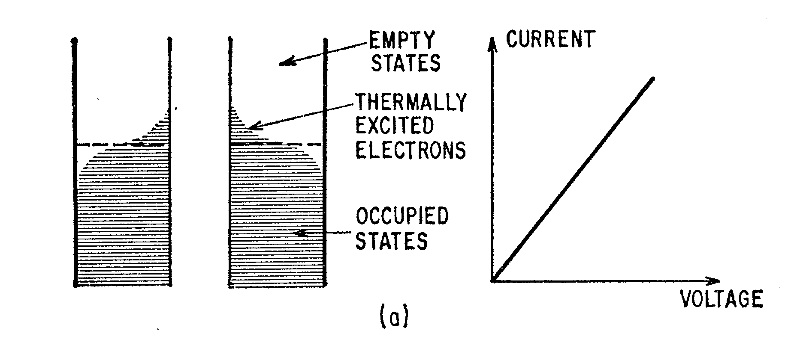
Electron Tunneling through an Insulator

Slide 5
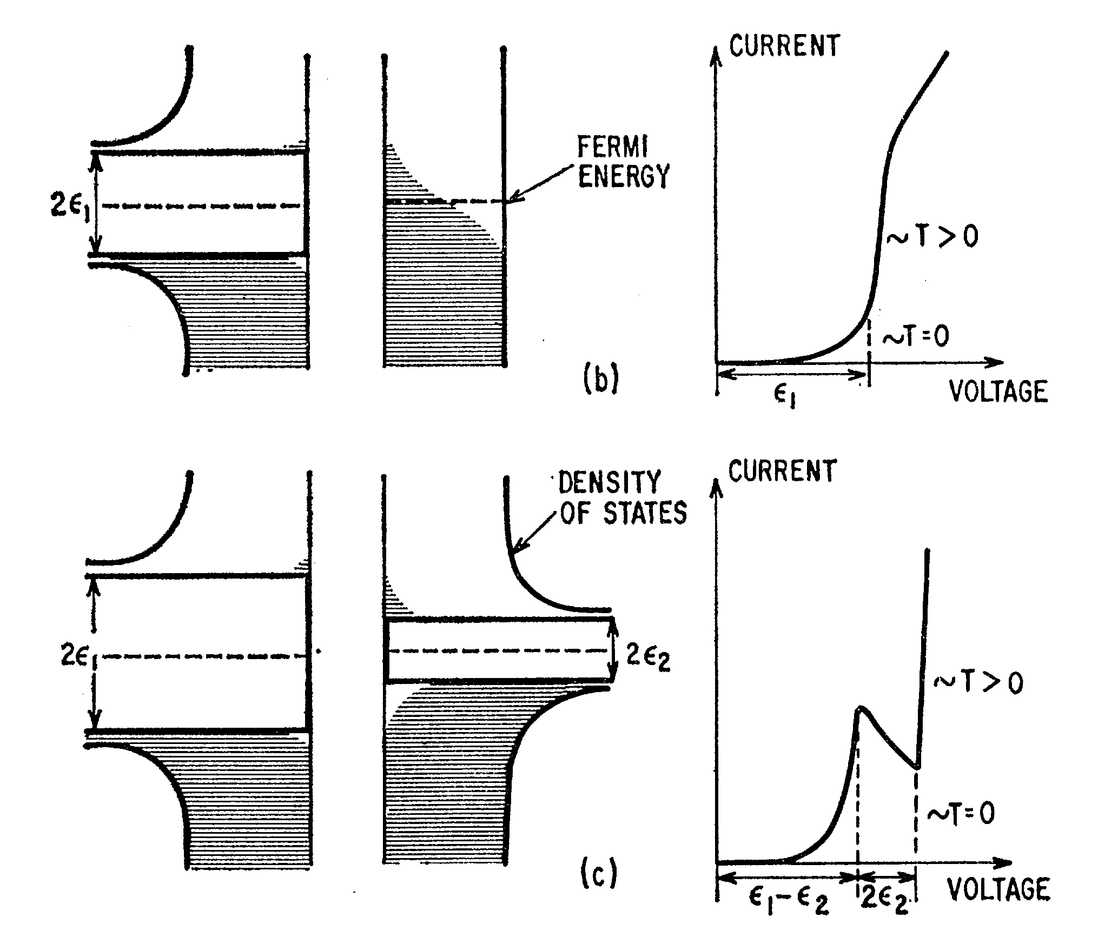

Slide 6
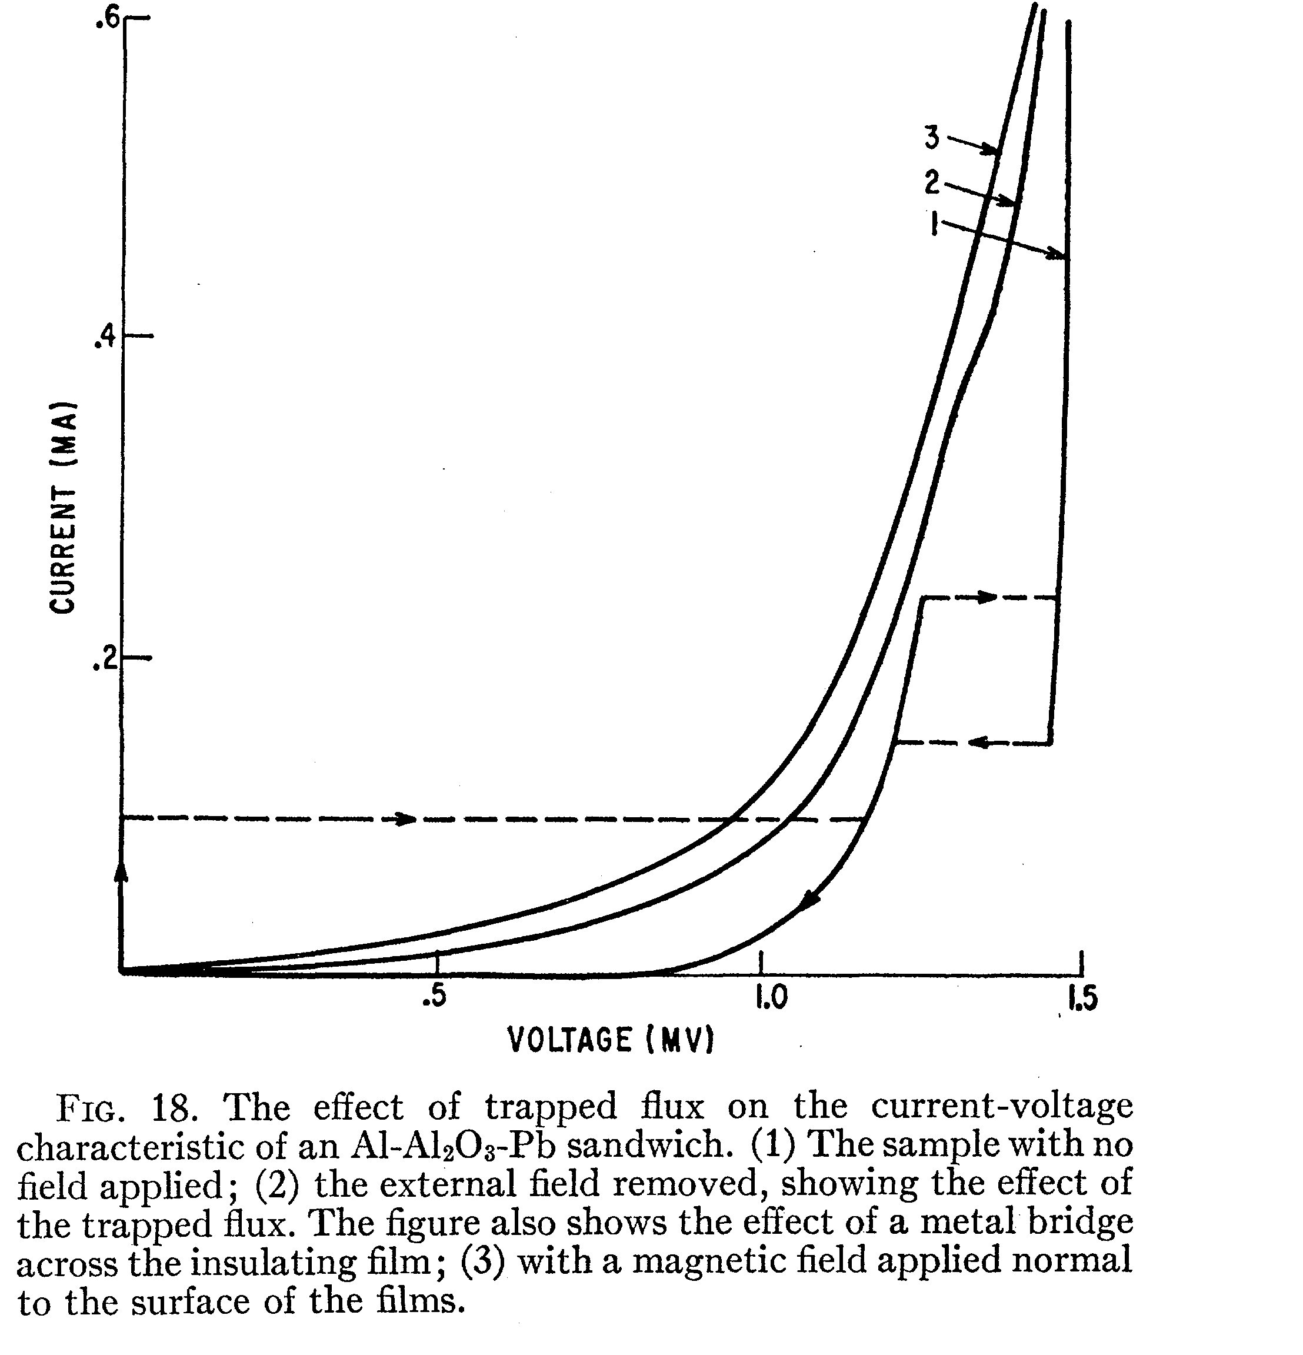

Slide 7
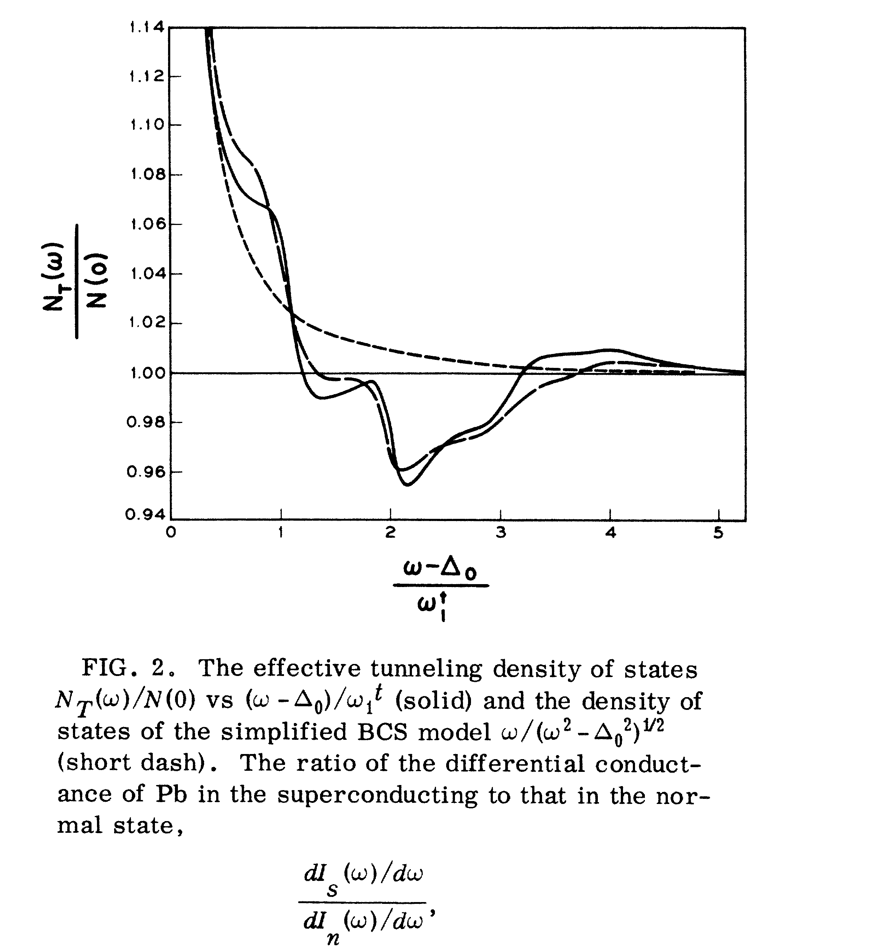

Slide 8
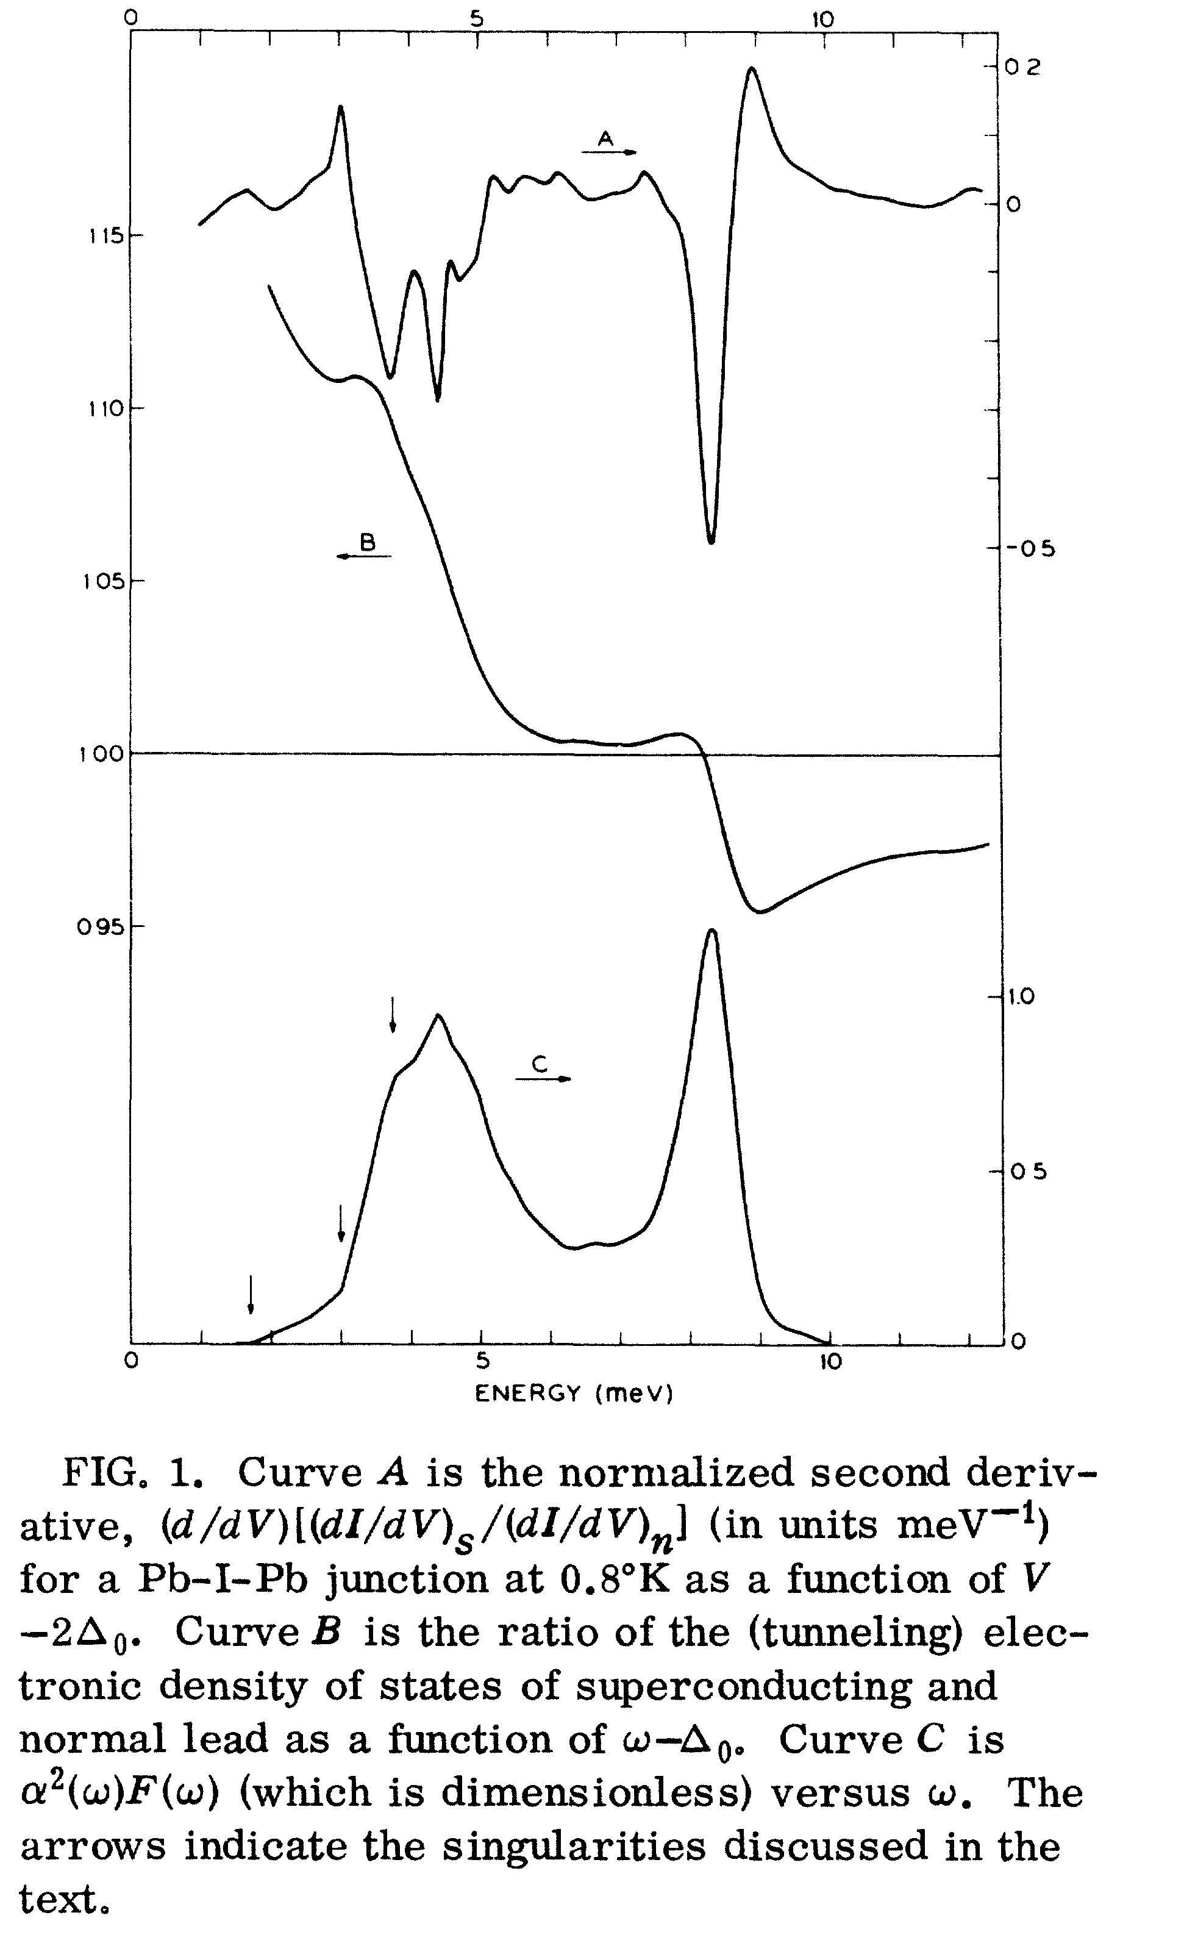

Slide 9
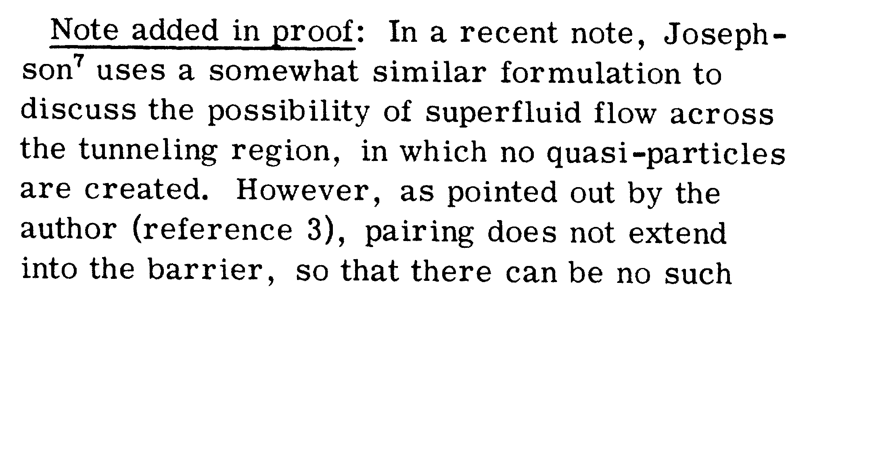

POSSIBLE NEW EFFEC'F3 IN SUPERCONDUCTIVE TUNNELLING *
B. D. JOSEPHSON
Cavendish Laboratory, Cambridge. England
Received 8 June 1962

Slide 11
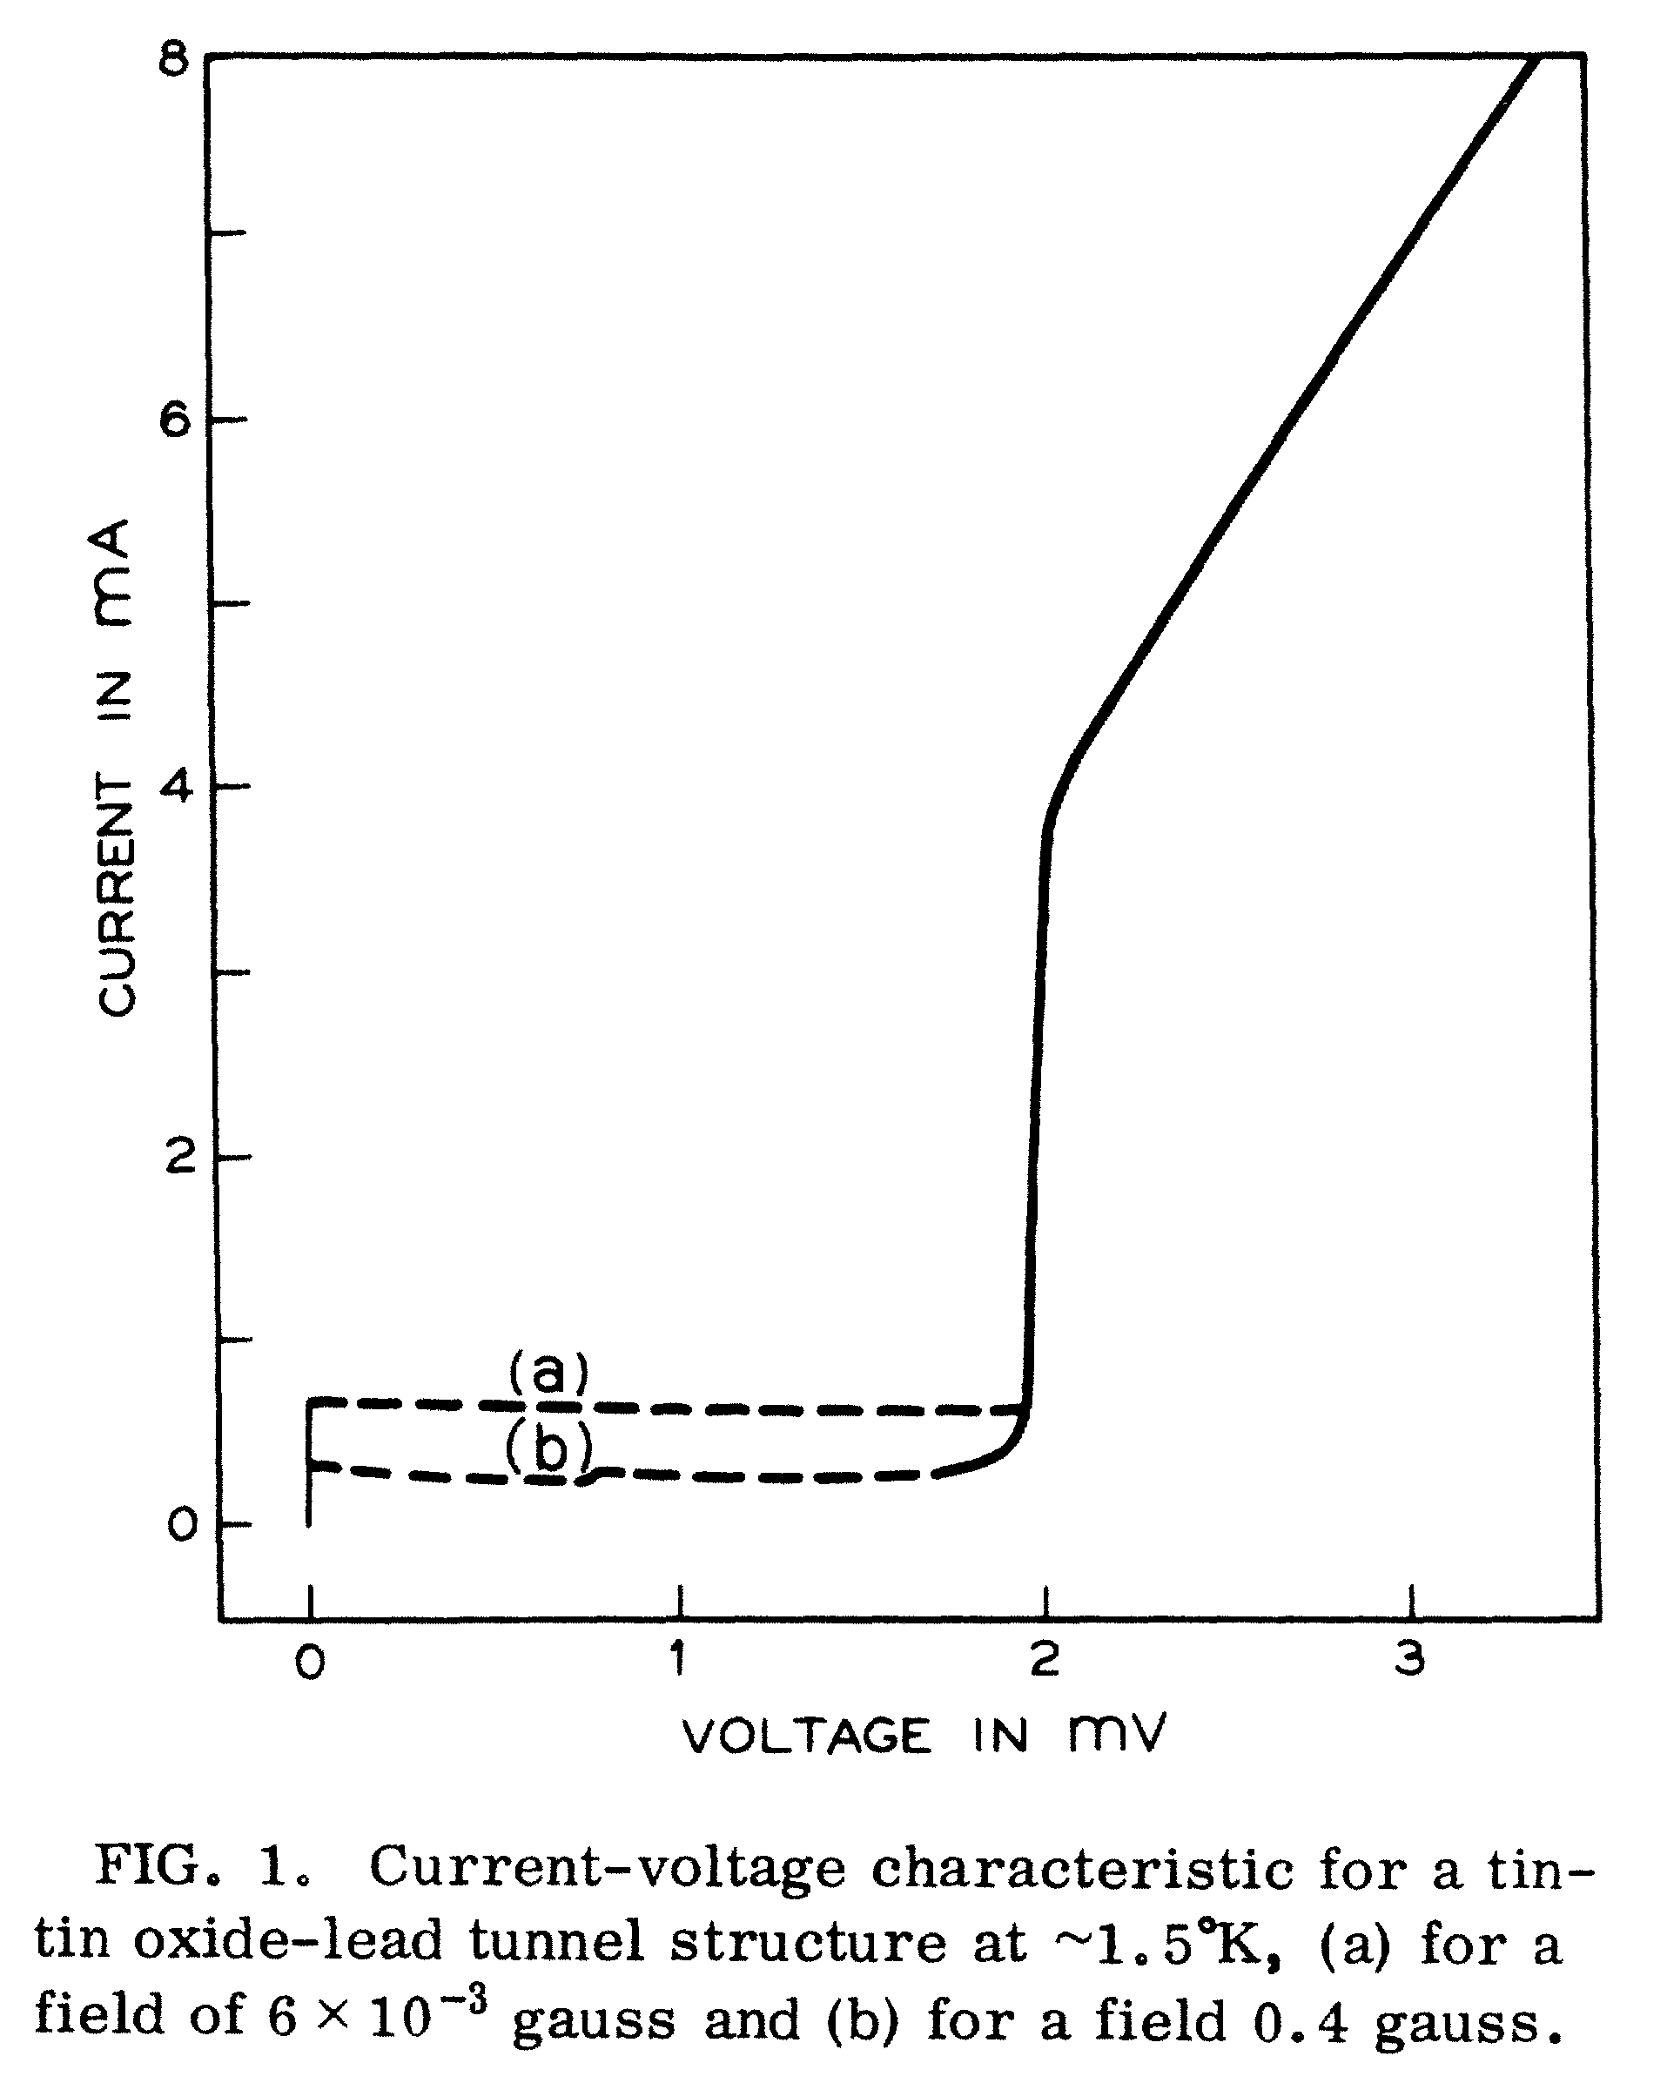

Slide 12
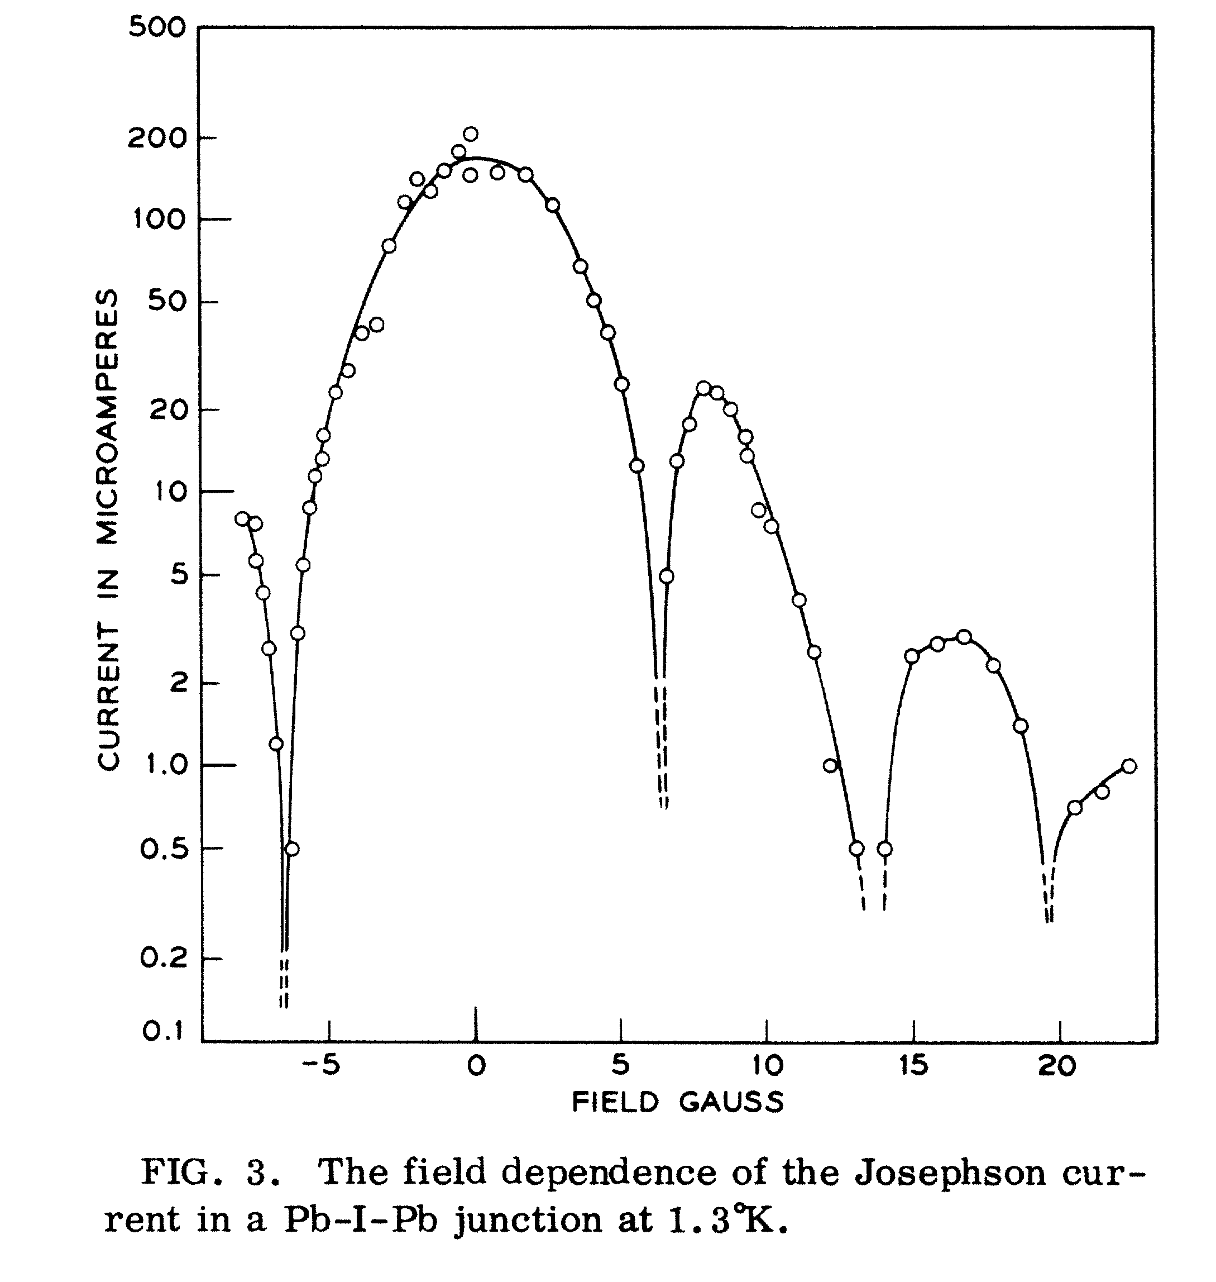

Slide 13
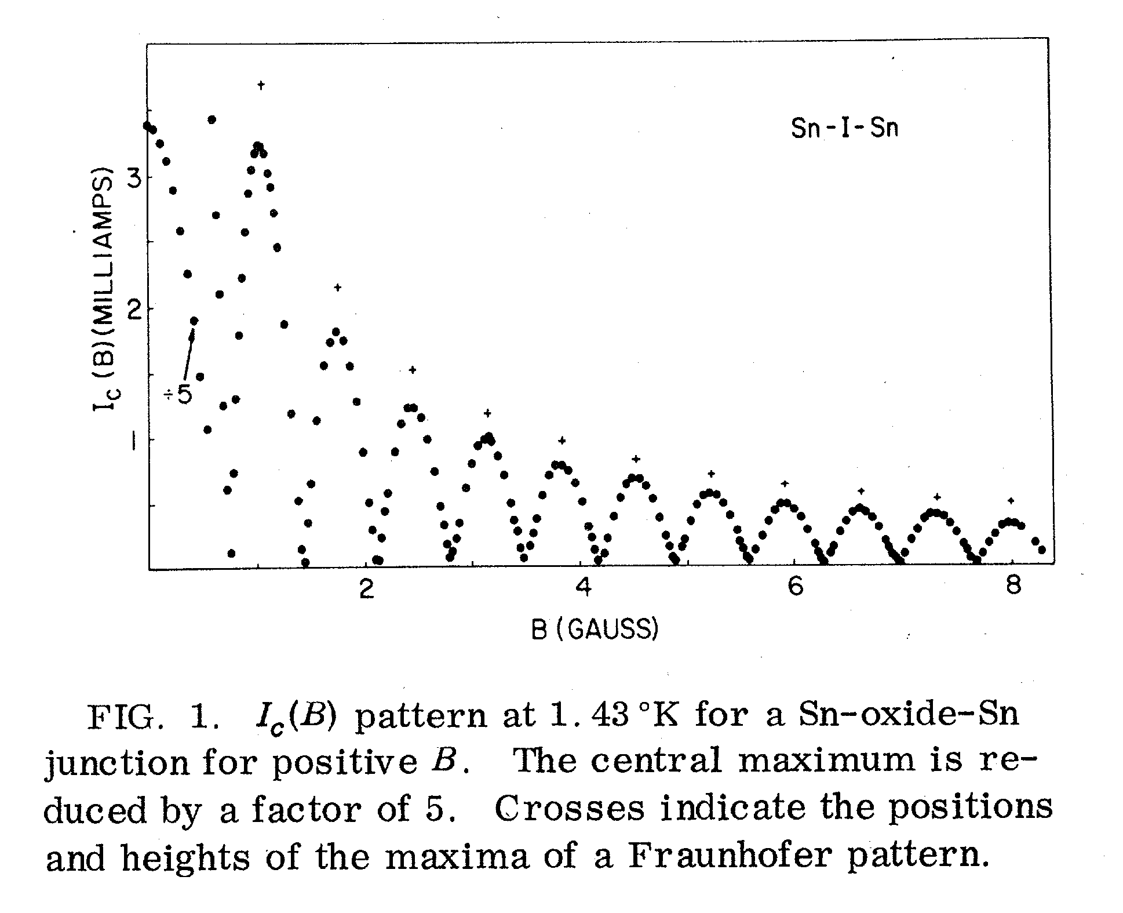

Slide 14
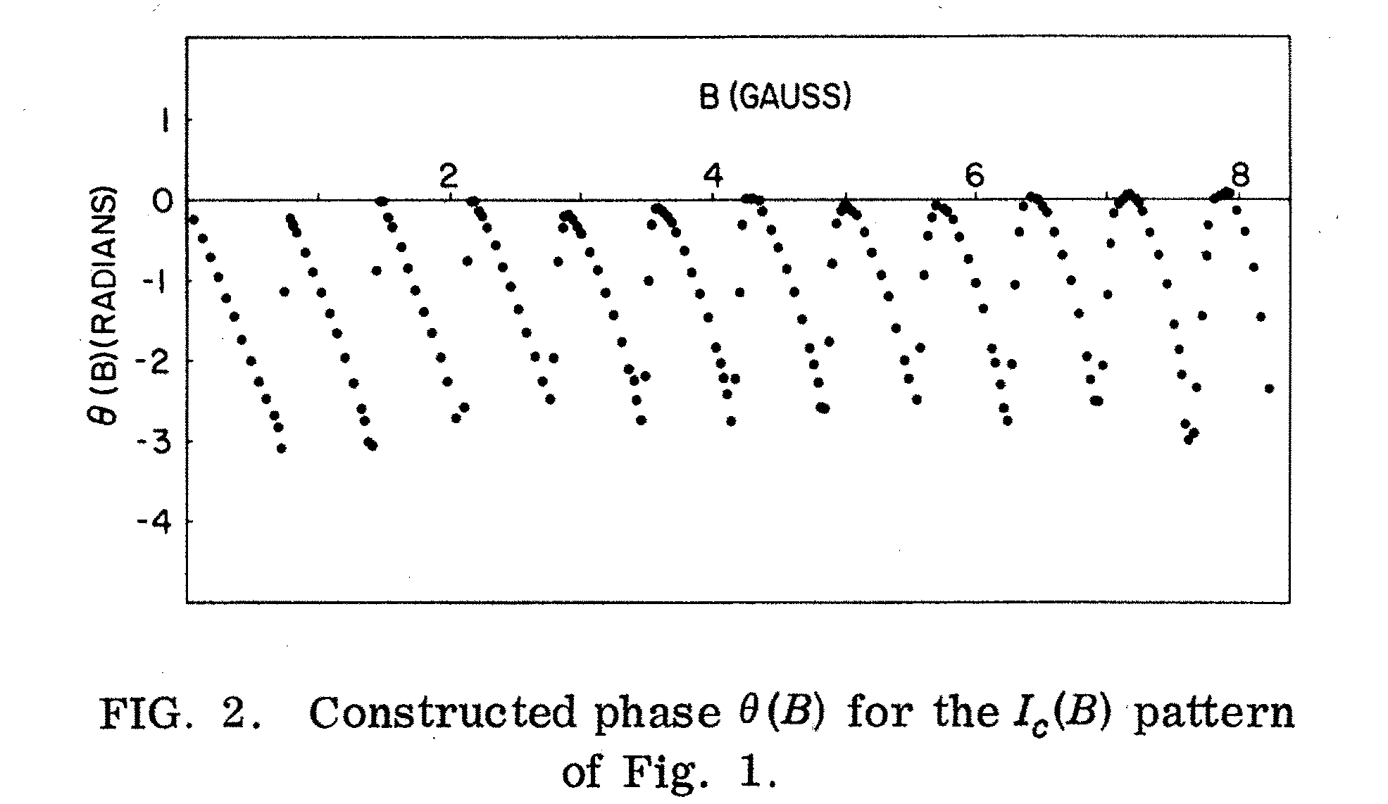

Slide 15
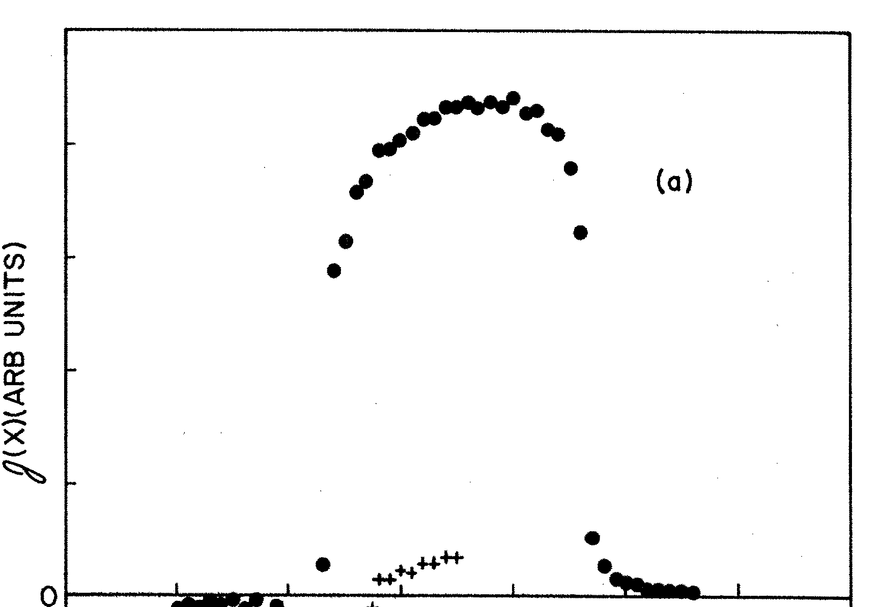

Slide 16
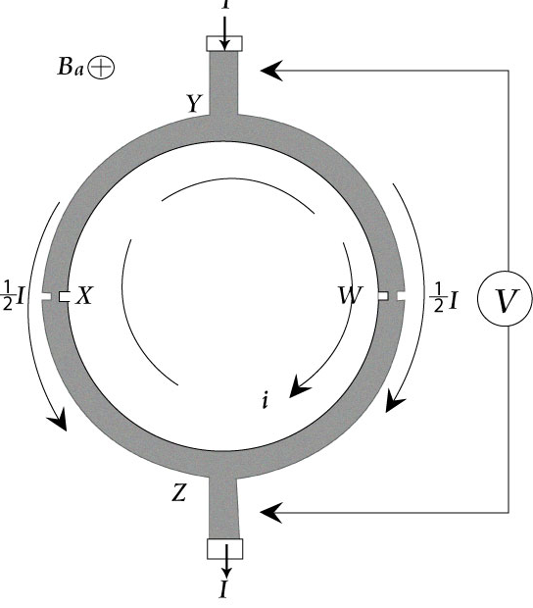


Slide 17
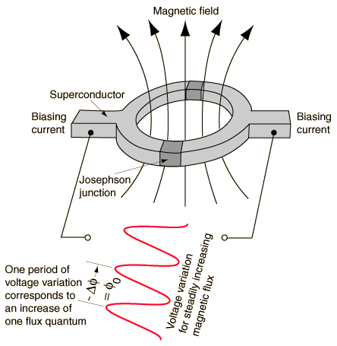

SQUID Magnetometer
The superconducting quantum interference device (SQUID) consists of two superconductors separated by thin insulating layers to form two parallel Josephson junctions. The device may be configured as a magnetometer to detect incredibly small magnetic fields -- small enough to measure the magnetic fields in living organisms. Squids have been used to measure the magnetic fields in mouse brains to test whether there might be enough magnetism to attribute their navigational ability to an internal compass.
The great sensitivity of the SQUID devices is associated with measuring changes in magnetic field associated with one flux quantum. One of the discoveries associated with Josephson junctions was that flux is quantized in units
If a constant biasing current is maintained in the SQUID device, the measured voltage oscillates with the changes in phase at the two junctions, which depends upon the change in the magnetic flux. Counting the oscillations allows you to evaluate the flux change which has occurred.

Slide 18

When a DC voltage is applied to a Josephson junction, an oscillation of frequency
occurs at the junction. Since this relationship of voltage to frequency involves only fundamental constants and since frequency can be measured with extreme accuracy, the Josephson junction has become the standard voltage measurement.
Josephson junction standards can yield voltages with accuracies of one part in 10^10. NIST has produced a chip with 19000 series junctions to measure voltages on the order of 10 volts with this accuracy.

